Slide 1

Platyhelminthes
Prepared by
Dr. Rawa Abdul Redha Aziz
Ph.D Antibiotics/ Molecular biology
Dr. Hiba Shakir Ahmed
Ph.D Microbiology/Immunity

Slide 2
Phylum – Platyhelminthes
Platyhelminthes are more complexly designed than the earlier groups.
They are bilaterally symmetrical.
They are triploblastic. This allows outside and inside body linings as well as some organs to be made. There is thus some degree of tissue formation [organ level of organization].
The body is flattened dorsiventrally, meaning from top to bottom, which is why these animals are called flatworms.
They may be freeliving or parasitic. Hooks and suckers are present in the parasitic forms.
Some examples are freeliving animals like planarians, or parasitic animals like

Slide 3
Parisites are mostly endoparasites found in animals including human beings. Some of them absorb nutrients from the host directly through their body surface.
Acoelomate: There is no true internal body cavity or coelom, in which well developed organs can be accommodated.
Specialised cells called flame cells help in osmoregulation and excretion.
Sexes are not separate.
Fertilisation is internal and development is indirect.
Some members like Planaria possess high regeneration capacity.

Slide 4
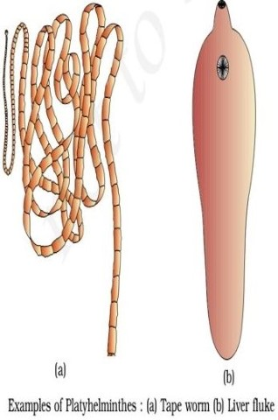

Slide 5
Phylum – Aschelminthes (Nemotoda)
Body in aschelminthes (Nemotoda) is cylindrical [bilaterally symmetrical] rather than flattened.
·They exhibit organ-system level of body organization [there are tissues, but no real organs].
·They are triploblastic. A sort of body cavity or a pseudocoelom, is present.
·They are freeliving, aquatic, terrestrial or parasitic in plants and animals.

Slide 6
·These are very familiar as parasitic worms causing diseases, such as the worms causing elephantiasis (filarial worms) or the worms in the intestines (roundworm or pinworms).
·The body is circular in cross-section, hence, the name roundworms.
·Alimentary canal is complete.
·An excretory tube removes body wastes from the body cavity through the excretory pore.
· Sexes are separate (dioecious), i.e., males and females are distinct.
· Often females are longer than males.
Fertilization is internal and development may be direct or indirect

Slide 7
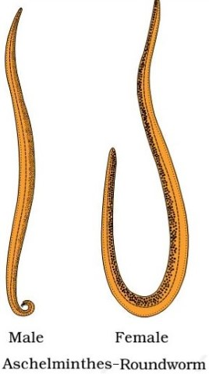

Slide 8
Phylum – Arthropoda
Insects, arachnids and crustaceans are members of the largest category of creatures on the planet: arthropods.
Arthropods have hard, external shells called “exoskeletons,” segmented bodies and jointed legs.
Some familiar examples are prawns, butterflies, houseflies, spiders, scorpions and crabs and some
They exhibit organ-system level of organisation.
They are bilaterally symmetrical, triploblastic, segmented and coelomate The coelomic cavity is blood-filled.
The body of arthropods is covered by chitinous The body consists of head, thorax and abdomen.

Slide 9
There is an open circulatory system, and so the blood does not flow in well defined blood vessels.
Respiratory organs are gills, book gills, book lungs or tracheal system.
Sensory organs like antennae, eyes (compound and simple), statocysts or balance organs are present.
Excretion takes place through malpighian tubules.
They are mostly dioecious.
Fertilisation is usually internal.
They are mostly oviparous.
Development may be direct or indirect

Slide 10
